Slide 1
Chapter 3:
Networking

Slide 2
Chapter Overview
Spam
Internet interactions
Text messaging
Censorship
Freedom of expression
Children and inappropriate content
Breaking trust
Internet addiction
1-<number>

Slide 3
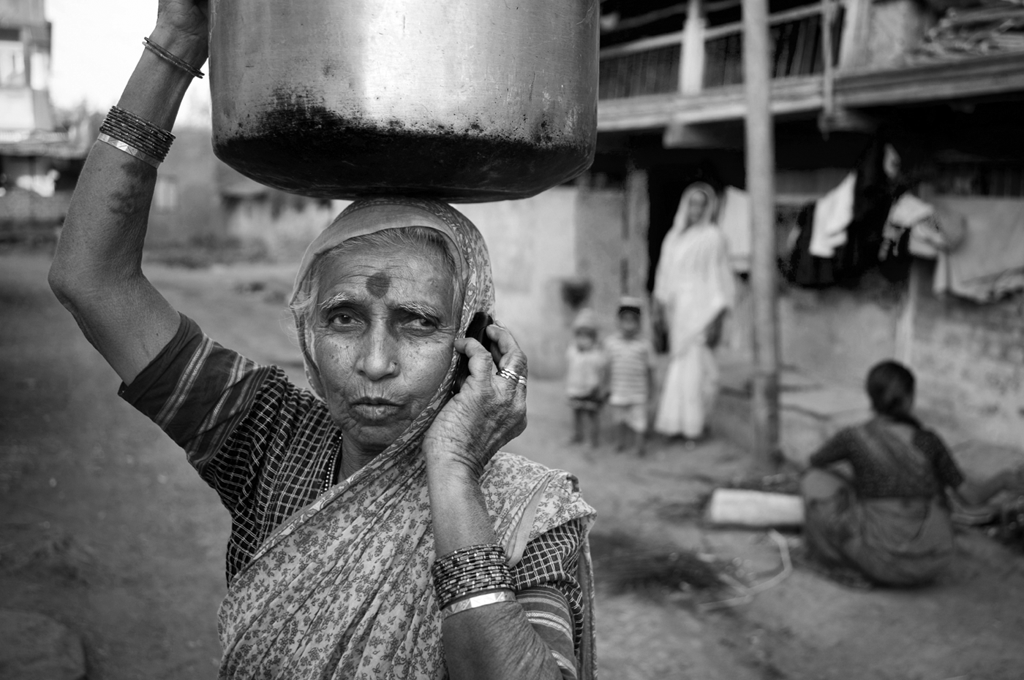
Far More People Have Access to Cell Phones than Electricity or Clean Water
Charles Sturge/Alamy
1-<number>

Slide 4
3.2 Spam
1-<number>

Slide 5
The Spam Epidemic (1/3)
Spam: Unsolicited, bulk email
Spam is profitable
  More than 100 times cheaper than “junk mail”
  Profitable even if only 1 in 100,000 buys product
Amount of email that is spam has ballooned
  8% in 2001
  90% in 2009
1-<number>

Slide 6
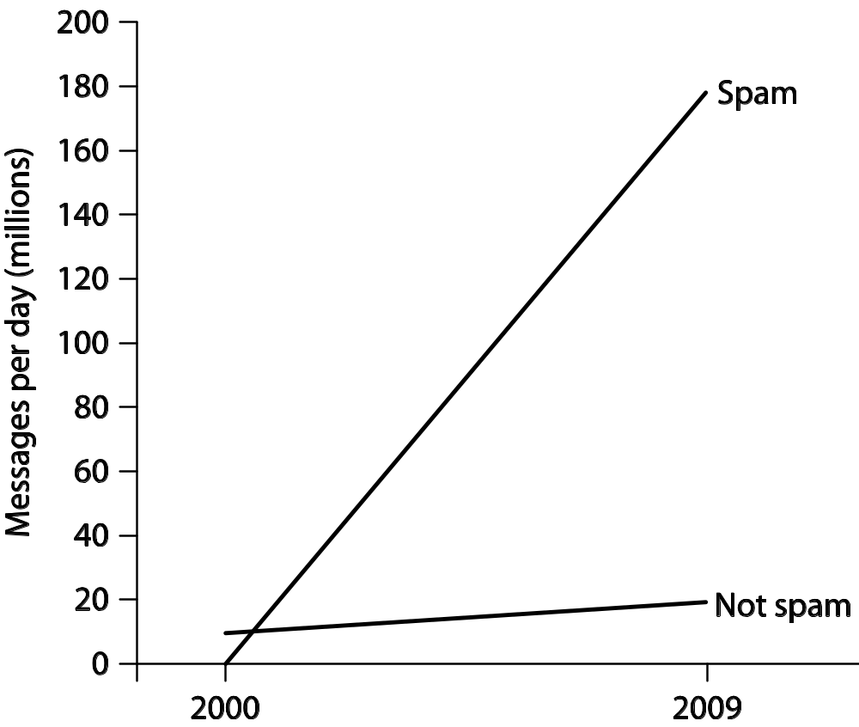
The Spam Epidemic (2/3)
1-<number>

Slide 7
The Spam Epidemic (3/3)
How firms get email addresses
  Web sites, chat-room conversations, newsgroups
  Computer viruses harvest addresses from PC address books
  Dictionary attacks
  Contests
Most spam sent out by bot herders who control huge networks of computers
Spam filters block most spam before it reaches users’ inboxes
1-<number>

Slide 8
Need for Socio-Technical Solutions
New technologies sometimes cause new social situations to emerge
  Calculators → feminization of bookkeeping
  Telephones → blurred work/home boundaries
Spam an example of this phenomenon
  Email messages practically free
  Profits increase with number of messages sent
  Strong motivation to send more messages
Internet design allows unfair, one-way communications
1-<number>

Slide 9
Case Study: Ann the Acme Accountant
Ann: Accountant at Acme Corporation
She distributes paychecks to all 50 employees
Ann sends email advertising Girl Scout cookie sale
9 recipients order cookies; average 4 boxes each
Other 40 recipients unhappy to get email; half complain to a co-worker
Did Ann do anything wrong?
1-<number>

Slide 10
Kantian Analysis
We should always respect autonomy of others, treating them as ends in themselves and never only as the means to an end (2nd formulation of Categorical Imperative)
Ann didn’t misrepresent what she was doing
She didn’t force anyone to read the entire email
Some who read her email chose to order cookies
Therefore, she didn’t “use” others, and her action was not strictly wrong
However, an “opt in” approach would have been better
1-<number>

Slide 11
Act Utilitarian Analysis
Benefit to Girls Scouts = $108
  $3 profit per box of cookies
  36 boxes sold
Harm to company: time wasted
  Orders taken during breaks
  Lost productivity from complaining: $70
    20 employees ×2 ×5 minutes/employee = 200 minutes
    3.5 hours ×$20/hour = $70
Benefits exceed harms, so action good
Company may create policy against future fundraisers
1-<number>

Slide 12
Rule Utilitarian Analysis
Q: What would be consequences of everyone in company used email to solicit donations?
A: Plenty of employee grumbling and lower morale
If all doing it, unlikely any one cause would do well
Harms greater than benefits, so Ann’s action was wrong
1-<number>

Slide 13
Social Contract Theory Analysis
Acme Corporation has no prohibition against using its email system this way
Ann was exercising her right to express herself
Some people didn’t appreciate message, but she didn’t act like a spammer
  She didn’t conceal her identity
  She wasn’t selling a fraudulent product
Ann did nothing wrong
1-<number>

Slide 14
Virtue Ethics Analysis
As employee, relevant virtues: honesty, fairness, respect
Ann was honest: her email didn’t mislead anyone
She wasn’t fair or respectful, and she exercised poor judgment (as evidenced by larger amount of complaining by co-workers)
In her role as parent, she did all work herself and didn’t find a role for her daughter to play
Ann should have found a way for her daughter to help, and she should have found another way to advertise that respected co-workers
1-<number>

Slide 15
Summary
Analyses reached different conclusions, but Ann could have taken a less controversial course
She could have posted a sign-up sheet to identify those interested in cookie sale
That way, she would have sent email only to those interested, avoiding the problems of grumbling and lost productivity
She could have found a way to get her daughter more engaged
1-<number>

Slide 16
3.3 Internet Interactions
1-<number>

Slide 17
The World Wide Web
WWW : networked hypertext system
Stimulated tremendous growth in popularity of Internet
Two important attributes
  It is decentralized
  Every Web object has a unique address
1-<number>

Slide 18
Rise of the App
People spending more time on smartphones and tablets
Using Web browsers awkward on mobile devices
Mobile apps replace Web browsers as way to access Internet on mobile devices
1-<number>

Slide 19
How We Use the Internet
Shopping
Socializing (e.g., Facebook)
Contributing content (e.g., wikis)
Blogging
Crowdsourcing
Learning
Exploring our roots
Entering virtual worlds
Controlling the Internet of Things
Paying taxes
Gambling
Taking humanitarian action
Lots more!
1-<number>

Slide 20
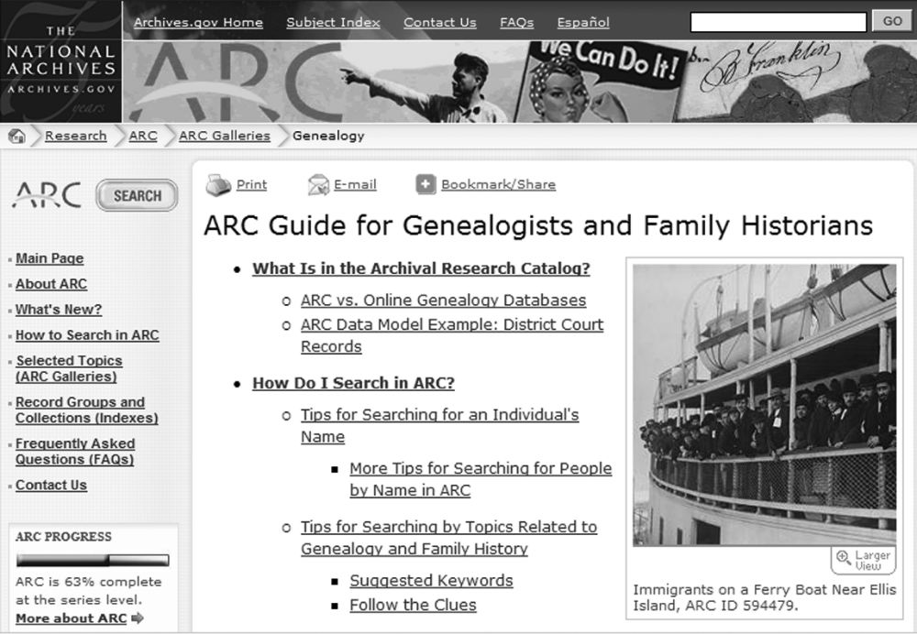
Online Source of Genealogical Information
1-<number>

